Slide 1


A O
Intelligence!
Team: Anusha Gona
Vamsi Krishna Kalepu
Krunal Dilip Shigavan
Nageswara Rao Ch
Notes:
To use this title animation slide with a new image simply 1) move the top semi-transparent shape to the side, 2) delete placeholder image, 3) click on the picture icon to add a new picture, 4) Move semi-transparent shape back to original position, 5) Update text on slide.

Slide 2


Software Overview and walk through
To Visualize our Analysis

Slide 3
Pentaho is Business Intelligence (BI) software that provides Data Integration, Online Analytical Processing (OLAP), Reporting, Dashboard, Data Mining and Extract, Transform, Load (ETL) services. The head office is in Orlando, Florida. Pentaho was acquired by Hitachi Data Systems in 2015 and became part of Hitachi Vantara in 2017.

Slide 4
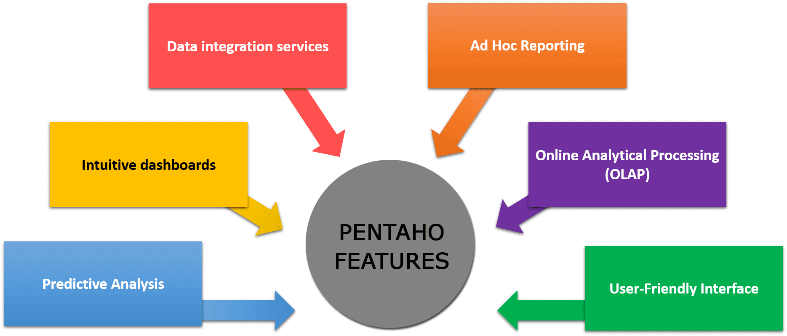

Slide 5
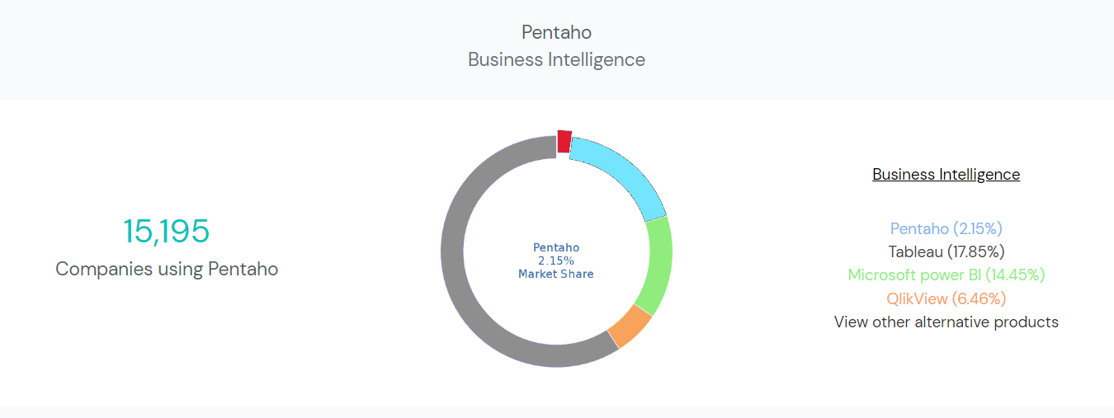
Pentaho
2.15%
Market Share
Pentaho(2.15%)
Tableau (17.85%)
Microsoft Power BI (14.45%)
QlikView (6.46%)
Other Alternative Products
Source: enlyft.com

Slide 6
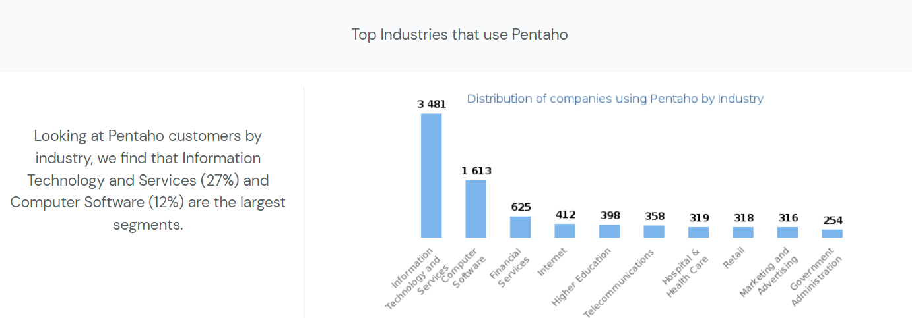
Source: enlyft.com

Slide 7

Use Case
John
Analytics Manager at a furniture sales company
He wants to create a sales dashboard to help the company understand its sales performance. To do this, he needs to collect sales data from the company's database. However, the file he receives is incomplete, and he needs to clean it up before he can use it.

Slide 8
DEMO

Slide 9
Power BI is a business analytics service provided by Microsoft that allows users to visualize and analyze data with interactive dashboards, reports, and visualizations. We created Power BI desktop application to create sales dashboard.

Slide 10
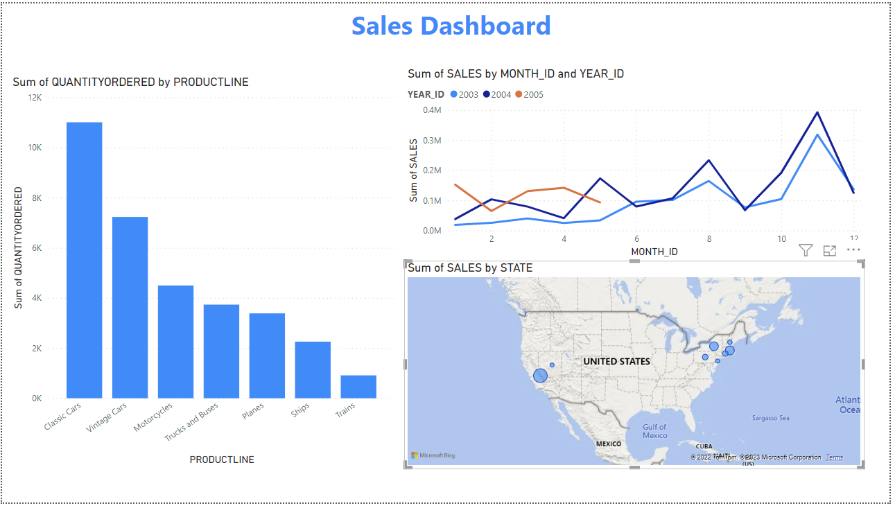

Slide 11
Conclusion..
Drive better decision making with BI and Analytics.
ETL(Extract, Transform and Load)
See the big picture and identify significance.
Track trends over time.

Slide 12
Thank You !
Notes:
To use this title animation slide with a new image simply 1) move the top semi-transparent shape to the side, 2) delete placeholder image, 3) click on the picture icon to add a new picture, 4) Move semi-transparent shape back to original position, 5) Update text on slide.

